Slide 1

DATA VISUALISATION PROJECT
Valeria Insogna, Cecilia Zagni
December 2022

Slide 2

INTRODUCTION
The dataset contains information about 17 major international events of figure skating, from October 2016 to December 2017.
Dataset source: https://github.com/BuzzFeedNews/2018-02-figure-skating-analysis
Notes:
In each event 8 categories compete: Ladies, Men, Ice dance, Pairs and their respective junior groups.
The competions have the same structure over all the categories. Each one is composed by 2 programs: short and free.
The athlete(s) final score is determined by the sum of the scores obtained in the two performances (short and free program).

Slide 3
HOW DOES AN EVENT WORK?
In each event, 8 categories compete: Ladies, Men, Ice dance, Pairs and their respective junior groups.
The competion has the same structure all over the categories. Each one is composed by 2 programs: short and free.
Athlete(s) final score = short program score+ free program score
Notes:
In each event 8 categories compete: Ladies, Men, Ice dance, Pairs and their respective junior groups.
The competions have the same structure over all the categories. Each one is composed by 2 programs: short and free.
The athlete(s) final score is determined by the sum of the scores obtained in the two performances (short and free program).

Slide 4
HOW TO CALCULATE THE SCORES?
In each performance two types of aspects are judged: elements (i.e. jumps and spins) and components (i.e. interpretation of the music and skating skills).
Performance score = elements score + components score
Element’s score = element’s base value + judge’s score
judge’s score ∈ [ -3, +3]
Component’s score = factor * judge’s score
judge’s score ∈ [ 0.25, 10]
Notes:
In each performance two types of aspects are judged: elements and components. The score of a performance is determined by the sum of the points of those two.
Elements are specific athletic gestures such as jumps and spins.
Components are more general aspects related to the performance, such as interpretation of the music, skating skills and transitions.
Each judge can give each element a score from -3 to +3.
The element base value is proportional to the difficulty of the element and it may differ among events.

Slide 5

DATASET
Some of the main information considered after preprocessing are:
event
category
program
athlete_name
athlete_nation
element_base_value
total_element_score
total_component_score
judge_nation
rank
…
You can find the processed dataset and code here.

Slide 6
QUESTIONS ADDRESSED
Do the judges favor compatriot athletes?
Which athletes present the most difficult elements and how are they ranked?
Are elements more important than components in establishing the final ranking?

Slide 7
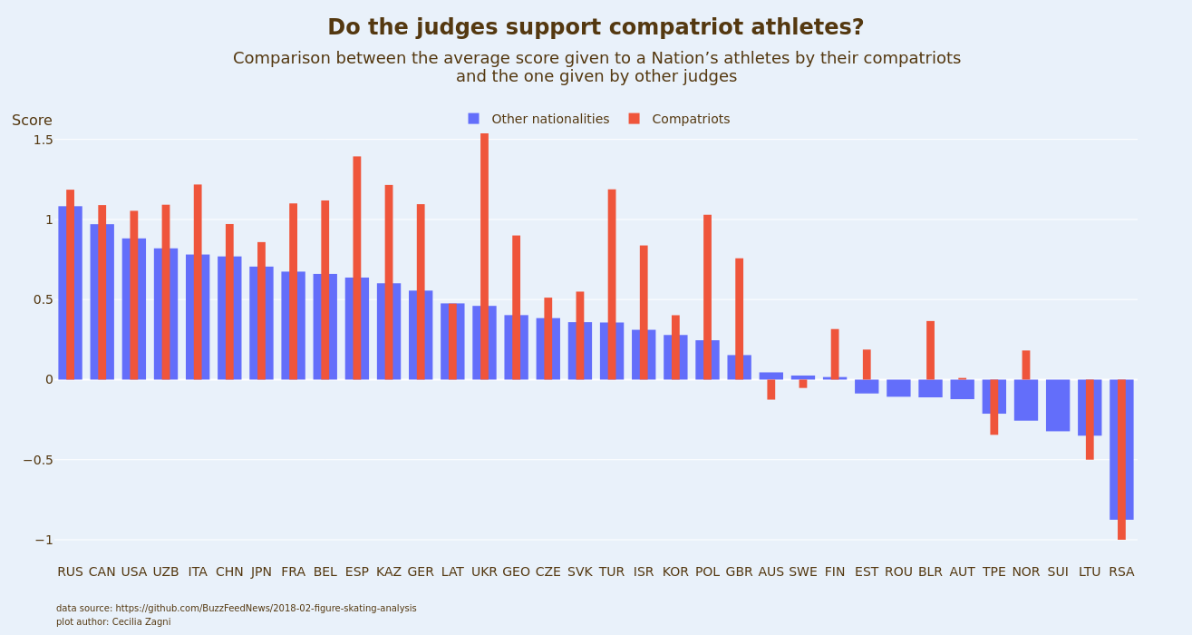

Slide 8
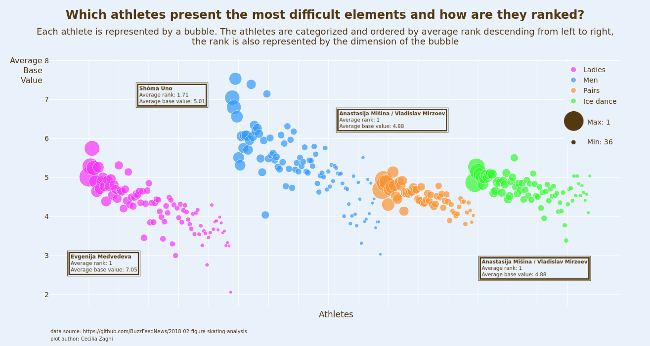

Slide 9
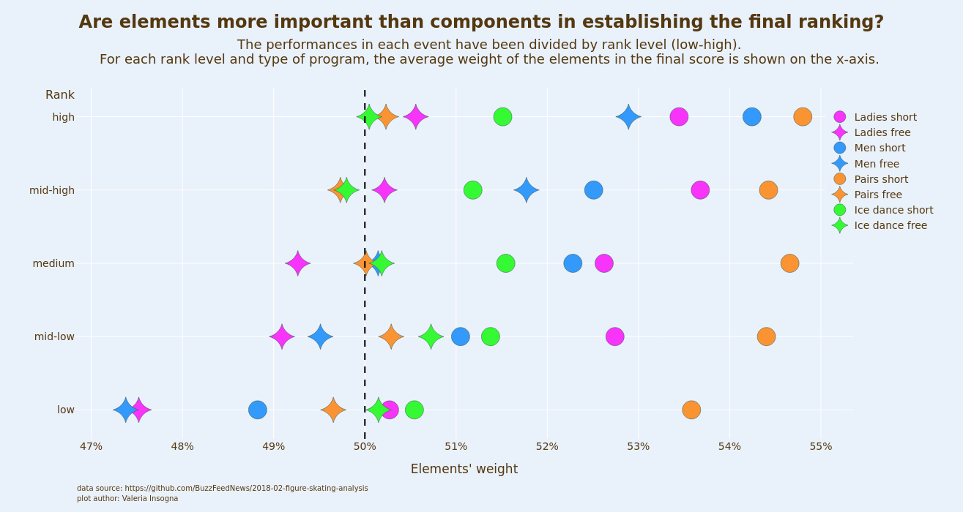

Slide 10
INDIVIDUAL CONTRIBUTIONS
Dataset preprocessing: Zagni.
Question brainstorming: Insogna, Zagni.
Question one data analysis and visualitazion: Zagni.
Question two data analysis and visualitazion: Insogna.
Question three data analysis : Insogna.
Question three visualitazion: Zagni.
Slides and refinements: Insogna, Zagni.

Slide 11
REFERENCES
https://github.com/BuzzFeedNews/2018-02-figure-skating-analysis
https://en.wikipedia.org/wiki/ISU_Judging_System#:~:text=The%20seven%20elements%20required%20of,spiral%2C%20and%20one%20step%20sequence.
https://www.usfigureskating.org/about/scoring-system
https://www.isu.org/figure-skating/rules/fsk-judging-system
11

Slide 12
LICENSE
Background image:
https://www.freepik.com/premium-photo/texture-blue-ice-surface-with-skate-scratches_5258233.htm (see premium license here).
12

